Slide 1
Final Presentation (Last presentation @ B.E.)
Kantapong V. (6004640030)

Slide 2
Recap – Previous Presentations
1) Proposal presentation → birds-eye views of my research ideas
Tools : Python notebook
2) Result presentation → detailed walkthrough of my process
Tools: R Markdown
3) Seminar discussion → mock-up example of EPU index
Tools: Python notebook (text mining)

Slide 3
Recap – Previous Presentations
1) Proposal presentation → birds-eye views of my research ideas
Tools : Python notebook
2) Result presentation → detailed walkthrough of my process
Tools: R Markdown
3) Seminar discussion → mock-up example of EPU index
Tools: Python notebook (text mining)
4) Today presentation → Combine both overview and walkthrough
Tools: Pencil and paper (really?)

Slide 4
Today Agenda
Telling my story
Saying goodbye
Today's AI is about new ways of connecting people to computers, people to knowledge, people to the physical world, and people to people.
PATRICK WINSTON, MIT AI Lab briefing, 1997

Slide 5
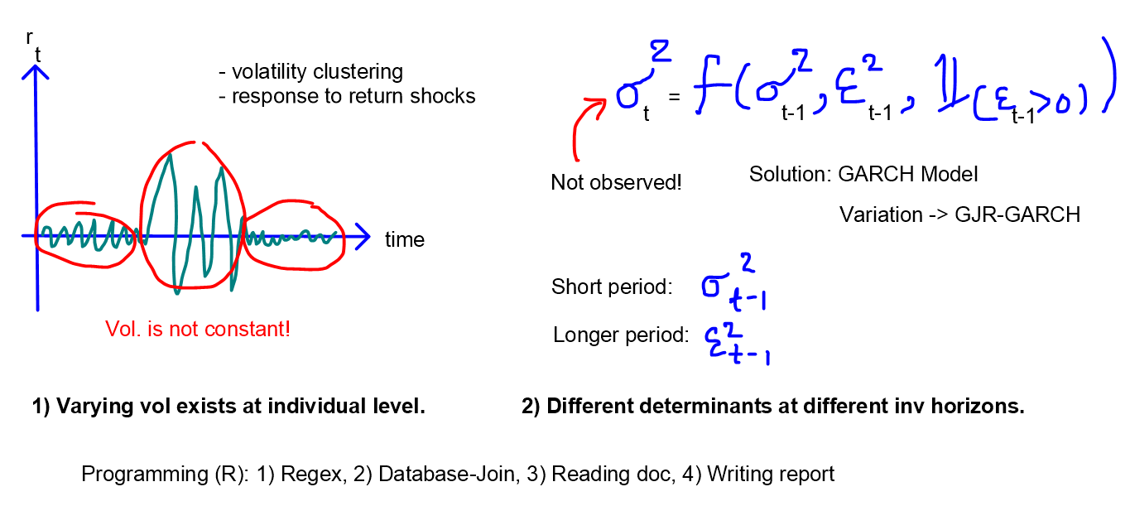
Telling my Story (from scratch!)

Slide 6
EE439 in a Nutshell!
Writing a research paper could be insanely difficult!
Dead-end is quite common in academics (more often than you think)
Missing part of the B.E. curriculum is how to clean data.
Proposal

Slide 7
EE439 in a Nutshell!
Writing a research paper could be insanely difficult!
Dead-end is quite common in academics (more often than you think)
Missing part of the B.E. curriculum is how to clean data.
Do you understand this? If so, code it up!
NLP is not magic if you see inside the black box.
Seminar Discussion

Slide 8
EE439 in a Nutshell!
Writing a research paper could be insanely difficult!
Dead-end is quite common in academics (more often than you think)
Missing part of the B.E. curriculum is how to clean data.
Do you understand this? If so, code it up!
NLP is not magic if you see inside the black box.
To solve Economics problems, transform to algorithmic first.
It is completely OK to step back and redesign your code.
Good design is important for communication.
Result

Slide 9
Birds-eye view from first-year to fourth-year
First-Year: Interested in making money out of trading
Theoretical Economics research must be my seminal paper.
Studying Ph.D. in Econ is a good choice.
Coding, CS: what??

Slide 10
Birds-eye view from first-year to fourth-year
First-Year: Interested in making money out of trading
Theoretical Economics research must be my seminal paper.
Studying Ph.D. in Econ is a good choice.
Coding, CS: what??
Fourth-Year: Doing trading all day long seems crazy!
Empirical paper is enough!
Master in Data Science and no Ph.D. anymore!
Coding, CS: my main tool in this course.
If you do not have anything to ask, just share your experiences!

Slide 11
Last Slide!
Have you ever heard “Five Minute University”? Five years after we graduate from B.E., the last thing we could remember is just supply and demand.

Slide 12
Last Slide!
Have you ever heard “Five Minute University”? Five years after we graduate from B.E., the last thing we could remember is just supply and demand.
I do not know whether this hypothesis will be true, but what I could be certain is that the content that I have presented in four presentations will be faded away as we progress.

Slide 13
Last Slide!
Have you ever heard “Five Minute University”? Five years after we graduate from B.E., the last thing we could remember is just supply and demand.
I do not know whether this hypothesis will be true, but what I could be certain is that the content that I have presented in four presentations will be faded away as we progress.
However, what will remain in your memory is our four-year experiences here. Good Luck on your Journey!

